Slide 1
Staying Connected with Children and Families: Through Technology
Early Educator Support Office
UNC Charlotte
Notes:
Welcome - introductions (Amy Jo will start us off)

Slide 2
Welcome!
We’re so happy you are here.

Slide 3
Zoom Etiquette
If the number of participants allow, we’ll have brief introductions.
Mute yourself when not talking so we don’t all hear each other’s background noises.
Try not to talk over others (it’s easy to do with this platform)- to assist with this, physically raise your hand if you have your video on, or use the “raise your hand” feature in the chat box.
If you have access to the video feature, please turn it on so we can all see one another. Seeing faces really helps to strengthen our connection. If you do this, be aware that your video is on and that everyone can see you.
Notes:
Amy Jo

Slide 4
Staying Connected Series Announcements
Keep conversation open and real - let’s plan on this hour to be a sharing of information that is as positive as possible.
We are recording the Staying Connected Series. Each recording will be added to the Early Educator Support website.
After this session, we will send out this powerpoint and your completion certificate for one contact hour. For those educators with an SPII license, this can be used toward your required renewal credits.

Slide 5
Discussion Topics:
How are you Connecting with Children and Families? How is it going so far?
The Importance of Connection
Activities, Ideas, Appropriateness
Strategies for Connecting
Notes:
Amy Jo

Slide 6
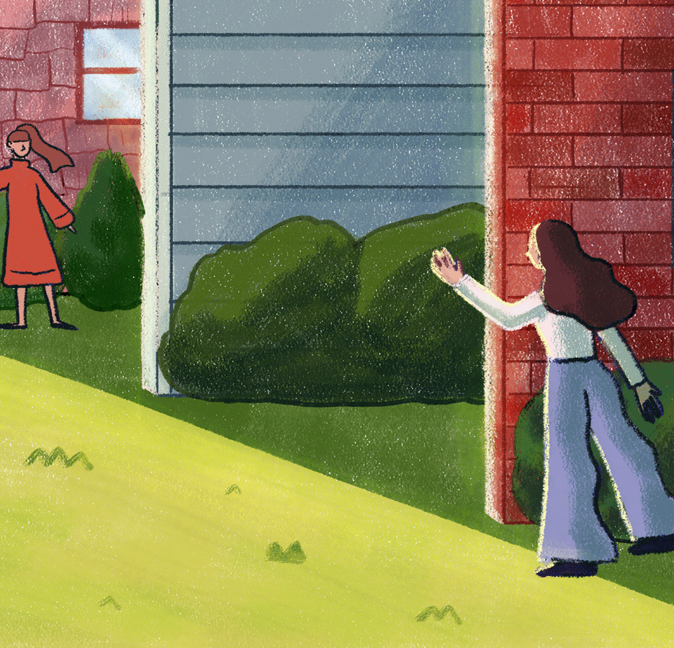

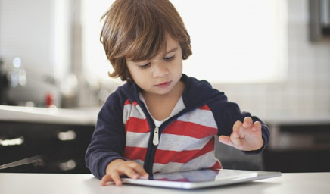
Connecting with Children and Families
What have you tried so far?
What is working/not working?
What support do you need?
Notes:
Niki

Slide 7
The Importance of Connection
Supports children who are missing classmates and teachers
Provides children/families with feelings of normalcy
Shows children/families that we care
Supports children and families in their adjustment to remote learning/interactions
Provides teachers with feelings of normalcy
It is an effective way for teachers to be aware of families’ needs, struggles, etc.
It is an opportunity to work on skills that the children need support on
Notes:
Mariel

Slide 8
Activity/Connection Ideas
Morning meeting
Sing songs/Fingerplays/Read books
Show and share or virtual dress up time
Lunch together
Walks outside; send pics(collages)through apps
Creating a family hand washing song w/ parents and share w/ teacher/classmates
Talk about feelings, emotions, fears, hopes, etc.
Notes:
Niki

Slide 9
Appropriateness of Using Technology
Screen time - how much?
Being mindful of other obligations (parents work/other family in the home)
Being mindful of data use or phone minutes (not everyone has unlimited minutes/data)
Notes:
Amy Jo

Slide 10
Strategies for Connecting
Using Technology
  Zoom meetings
  Apps (Class DoJo, Marco Polo, Google Duo, Walkie Talkie(iPhone only), Flipgrid, Remind, Seesaw)
  Sending videos to children, phone calls, voicemails
No Tech
  Sending home materials
  Sending postcards or shorthand written letters
  Sending learning packages with differentiated activities for the children (based on assessment data). Delivering them at home?
Notes:
Amy Jo is talking tech - Mariel is talking no tech

Slide 11



